Slide 1
Project Planning Lightning Talk
sdmay25-26 Bryce Rega, Marek Jablonski, Gavin Patel, Jonah Frosch, Long Yu Cost-Effective and Easily Configurable High Voltage Motor Controllers for Automotive Use
October 15th, 2024

Slide 2
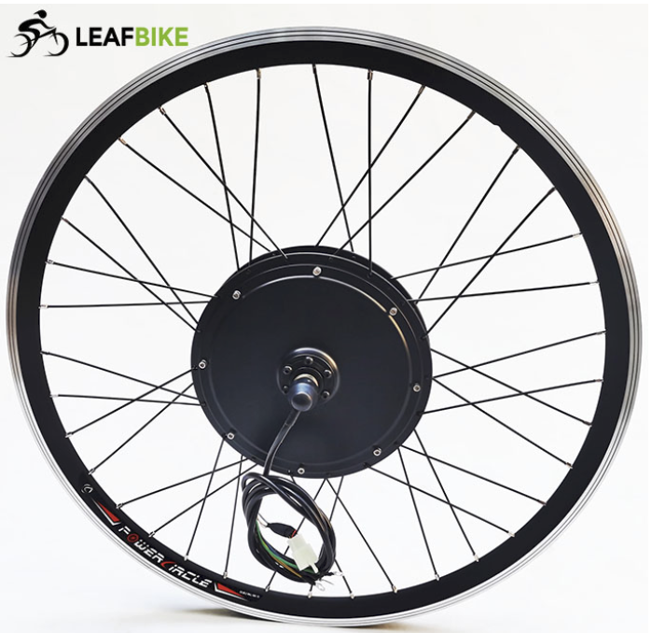
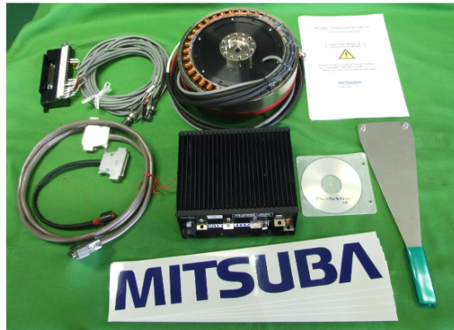
Project Overview
Custom High Voltage Motor Controller
Low Total cost for controller when compared to market options
Develop a GUI for interfacing and configuring controller
Compatible with many different applications

Slide 3
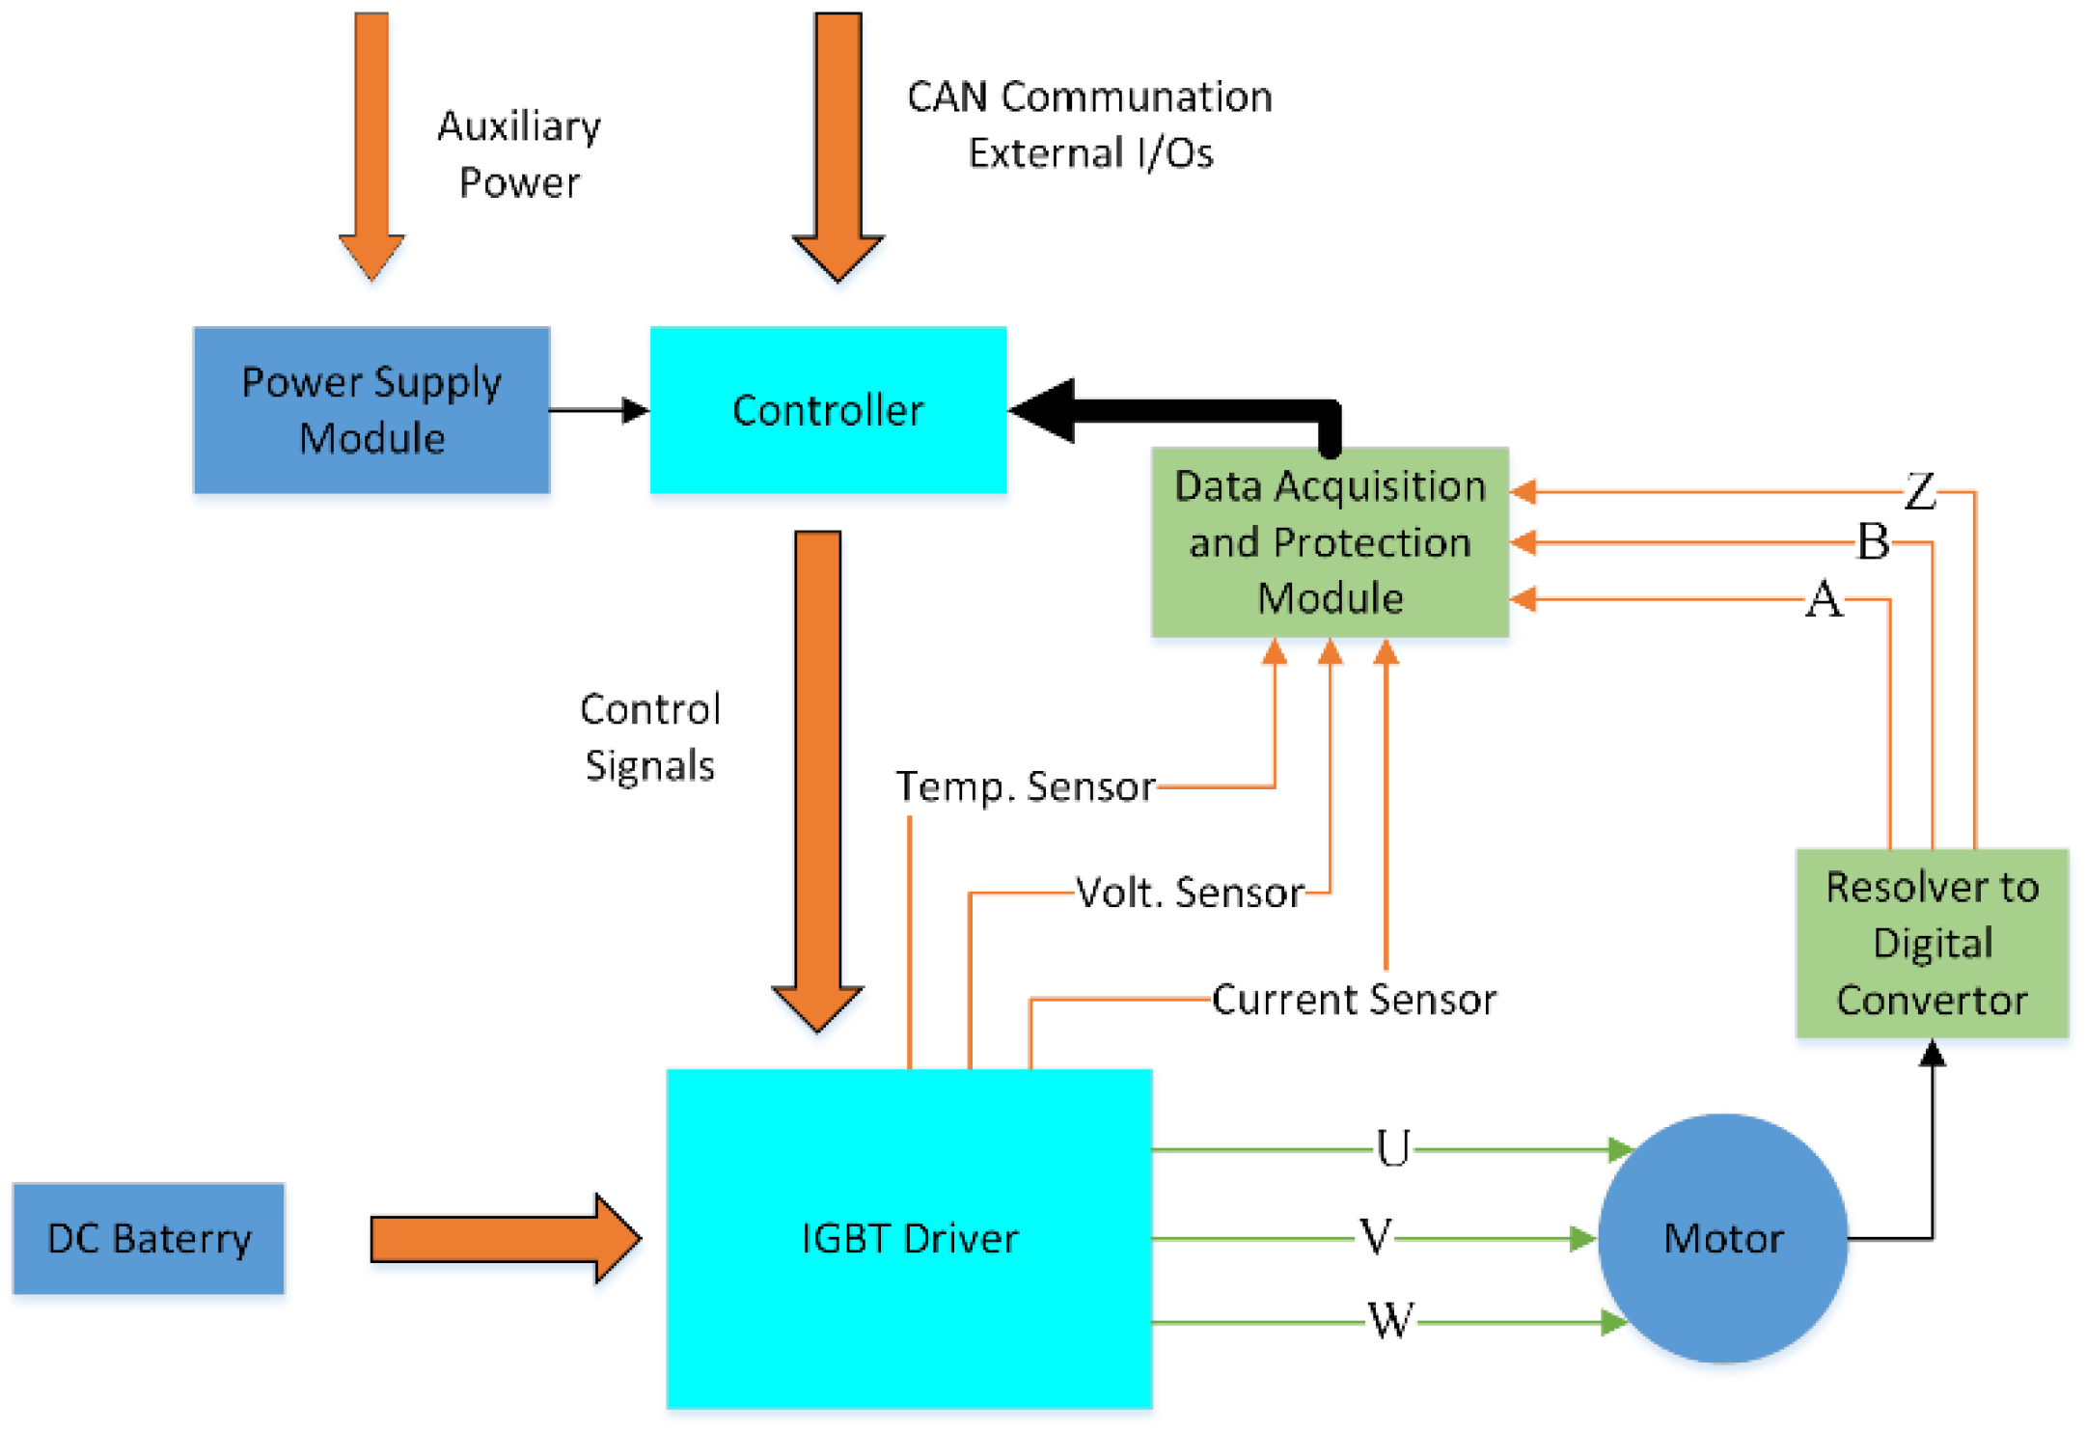
In this project will we be designing the architecture and implementation of a motor controller for lightweight automotive use.

Slide 4
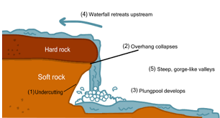
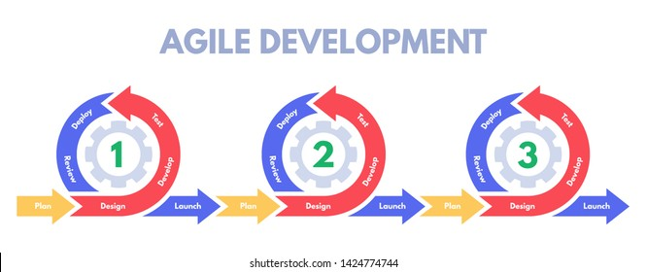
Project Management Style
Waterfall and Agile hybrid for hardware
Revisiting of previous work may be required
Hardware design is a more rigid process
Overall a more streamlined design process
Agile for software development
Plan features to be added
Better suited for our development structure
A more fluid work process, no A to B steps

Slide 5
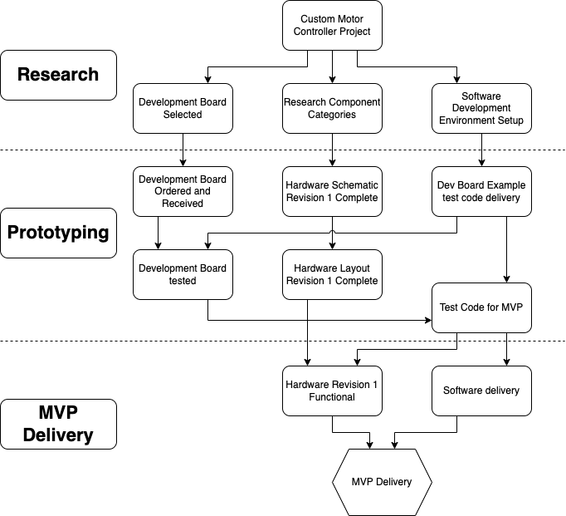
Task Decomposition
Research
Select dev board and software prep
Research components
Prototyping
Develop and test software on dev board
Create schematic, then layout of PCB
Prototype software for custom PCB
Minimum Viable Product (MVP)
Hardware is functional and tested
Software is functional and tested
Revision 1 (MVP) is complete

Slide 6
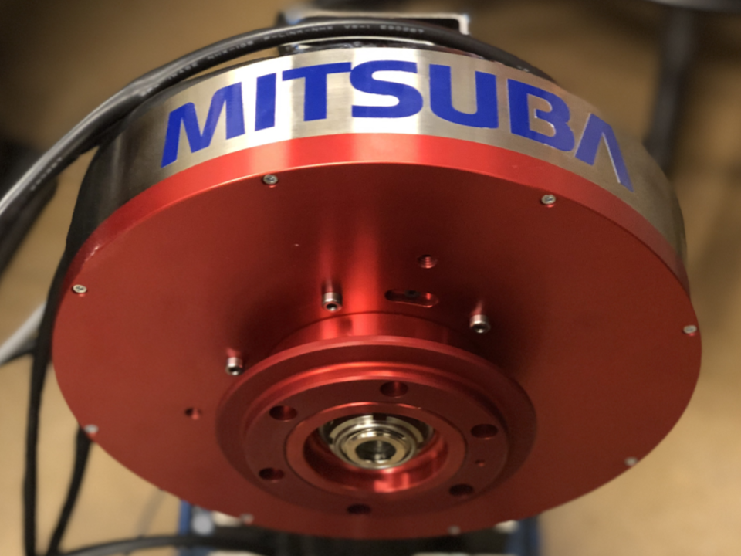
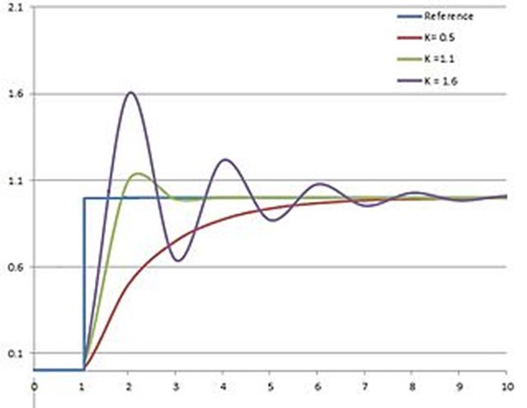
Milestones and Metrics
Development Board Controls Motor
Motor is visibly spinning in the correct direction
Current control has expected results
Some percentage of throttle equals the measured current over the maximum current
Custom PCB Controls Motor
Using the same metrics as above
CAN input results in motor responding
CAN output is read and accurate with CAN receiver (CAN Pi)
Efficiency is measured by comparing idle power at a given speed on same motor with to an existing controller
PID RPM Functions
Accuracy is measured using tachometer and input RPM

Slide 7
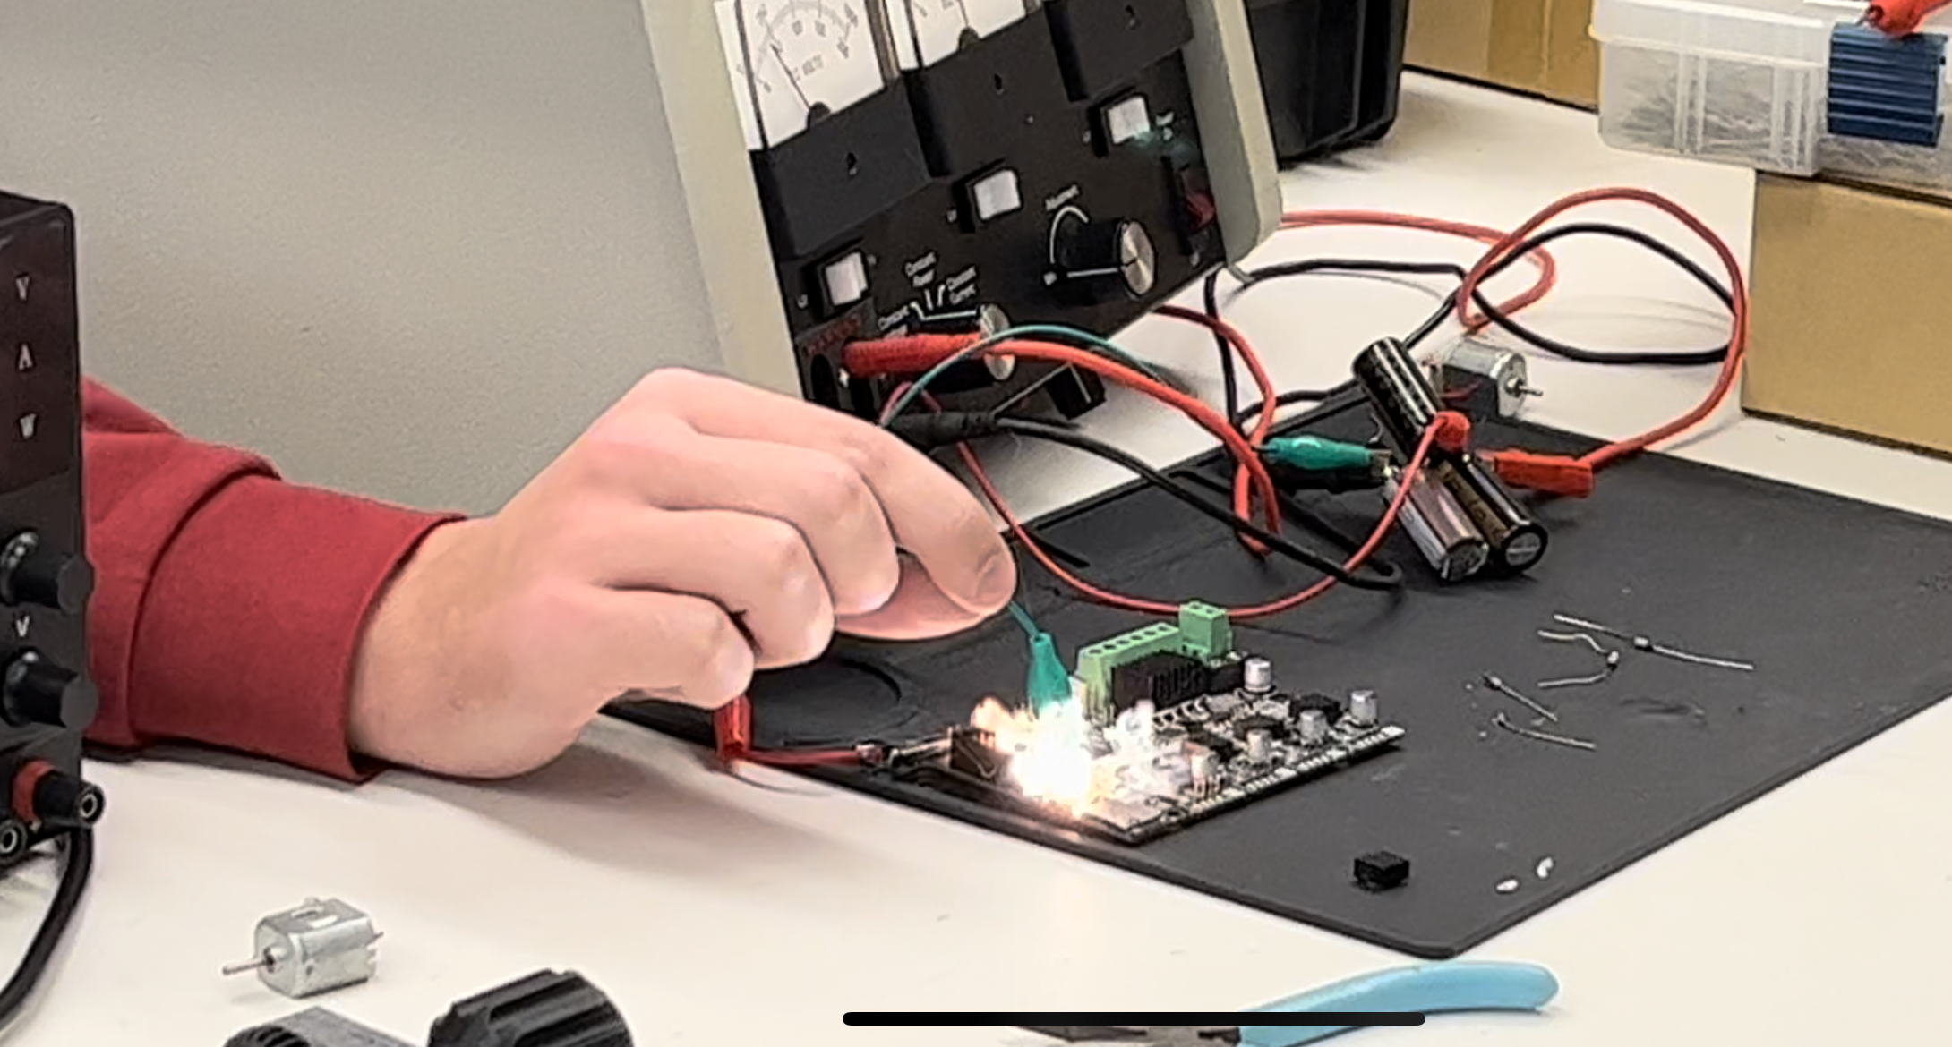
Handling Risk
Additional Resources Required
Likelihood: Low
Mitigation: Proper project planning and research
Tasks taking longer than anticipated
Likelihood: High
Mitigation: Flexibility in planning
Scope Creep
Likelihood: Medium
Mitigation: Tiered requirements in end results

Slide 8
Conclusion
We aim to develop a motor controller that applies to multiple applications. This required us to make a lightweight motor controller affordable, easy to use and adapt, and have plug-in diagnostics for troubleshooting. This can be developed into a set of milestones with specific metrics to gauge our progress.

